Slide 1
Authentication with JWT

Slide 2
What is JWT?
JSON Web Token, or JWT (“jot”) for short, is a standard for safely passing claims in space constrained environments.
It has found its way into all major web frameworks.
Simplicity, compactness and usability are key features of its architecture.
Although much more complex systems are still in use, JWTs have a broad range of applications.

Slide 3
What is JWT? (continued)
A JSON Web Token looks like this (newlines inserted for readability):
eyJhbGciOiJIUzI1NiIsInR5cCI6IkpXVCJ9.
eyJzdWIiOiIxMjM0NTY3ODkwIiwibmFtZSI6IkpvaG4gRG9lIiwiYWRtaW4iOnRydWV9.
TJVA95OrM7E2cBab30RMHrHDcEfxjoYZgeFONFh7HgQ
While this looks like gibberish, it is actually a very compact, printable representation of a series of claims, along with a signature to verify its authenticity.
{
"alg": "HS256",
"typ": "JWT"
}
{
"sub": "1234567890",
"name": "John Doe",
"admin": true
}

Slide 4
What is JWT? (continued)
Claims are definitions or assertions made about a certain party or object.
Some of these claims and their meaning are defined as part of the JWT spec. Others are user defined.
The magic behind JWTs is that they standardize certain claims that are useful in the context of some common operations.
For example, one of these common operations is establishing the identity of certain party.
So one of the standard claims found in JWTs is the sub (from “subject”) claim.

Slide 5
What problem do JWTs solve?
Although the main purpose of JWTs is to transfer claims between two parties, arguably the most important aspect of this is the standardization effort in the form of a simple, optionally validated and/or encrypted, container format.
Ad hoc solutions to this same problem have been implemented both privately and publicly in the past.
Older standards for establishing claims about certain parties are also available.
What JWT brings to the table is a simple, useful, standard container format.

Slide 6
What problem do JWTs solve?
Although the definition given is a bit abstract so far, it is not hard to imagine how they can be used:
login systems (although other uses are possible).
Some other practical applications include:
Authentication
Authorization
Federated identity
Client-side sessions (“stateless” sessions)
Client-side secrets

Slide 7
History of JWT
The JSON Object Signing and Encryption group (JOSE) was formed in the year 2011.
The group’s objective was to “standardize the mechanism for integrity protection (signature and MAC) and encryption as well as the format for keys and algorithm identifiers to support interoperability of security services for protocols that use JSON”.
By year 2013 a series of drafts, including a cookbook with different examples of the use of the ideas produced by the group, were available.
One of these drafts would later become the JWT (Request for Comments) RFCs.

Slide 8
Client-side/Stateless Sessions
Stateless sessions are in fact nothing more than client-side data.
The key aspect of this application lies in the use of signing and possibly encryption to authenticate and protect the contents of the session.
Client-side data is subject to tampering. As such it must be handled with great care by the backend.
JWTs, can provide various types of signatures and encryption.
Signatures are useful to validate the data against tampering.
Encryption is useful to protect the data from being read by third parties.

Slide 9
Client-side/Stateless Sessions (continued)
Most of the time sessions need only be signed.
In other words, there is no security or privacy concern when data stored in them is read by third parties.
A common example of a claim that can usually be safely read by third parties is the sub claim (“subject”).
The subject claim usually identifies one of the parties to the other (think of user IDs or emails).
It is not a requirement that this claim be unique. In other words, additional claims may be required to uniquely identify a user.

Slide 10
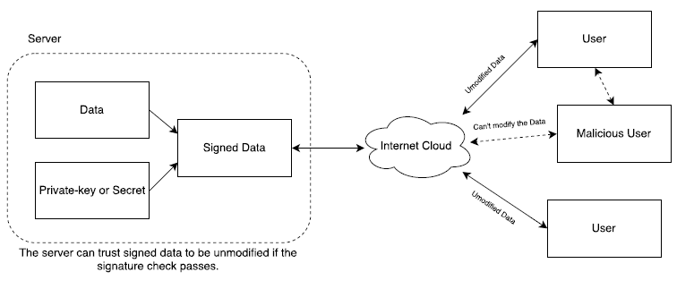
Client-side/Stateless Sessions (continued)
A claim that may not be appropriately left in the open could be an “items” claim representing a user’s shopping cart.
This cart might be filled with items that the user is about to purchase and thus are associated to his or her session.
A third party (a client-side script) might be able to harvest these items if they are stored in an unencrypted JWT, which could raise privacy concerns.

Slide 11
Security Considerations
Signature Stripping
A common method for attacking a signed JWT is to simply remove the signature.
Signed JWTs are constructed from three different parts: the header, the payload, and the signature.
These three parts are encoded separately. As such, it is possible to remove the signature and then change the header to claim the JWT is unsigned.
Careless use of certain JWT validation libraries can result in unsigned tokens being taken as valid tokens, which may allow an attacker to modify the payload at his or her discretion.
This is easily solved by making sure that the application that performs the validation does not consider unsigned JWTs valid.

Slide 12
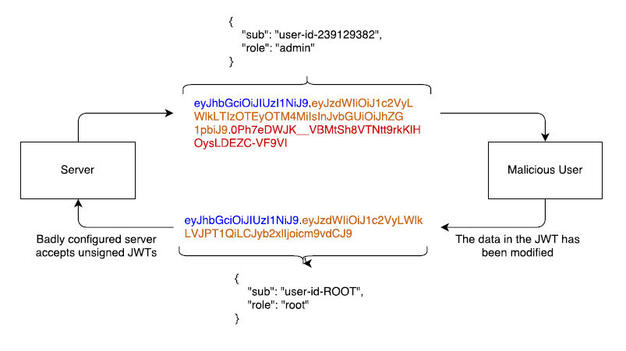
Security Considerations
Signature Stripping (continued)

Slide 13
Security Considerations
Cross-Site Request Forgery (CSRF)
Cross-site request forgery attacks attempt to perform requests against sites where the user is logged in by tricking the user’s browser into sending a request from a different site.
To accomplish this, a specially crafted site (or item) must contain the URL to the target.
A common example is an <img> tag embedded in a malicious page with the src pointing to the attack’s target.
<!-- This is embedded in another domain's site -->
<img src="http://target.site.com/add-user?user=name&grant=admin">

Slide 14
Security Considerations
Cross-Site Request Forgery (CSRF) (continued)
The above <img> tag will send a request to target.site.com every time the page that contains it is loaded.
If the user had previously logged in to target.site.com and the site used a cookie to keep the session active, this cookie will be sent as well.
If the target site does not implement any CSRF mitigation techniques, the request will be handled as a valid request on behalf of the user.
JWTs, like any other client-side data, can be stored as cookies.

Slide 15
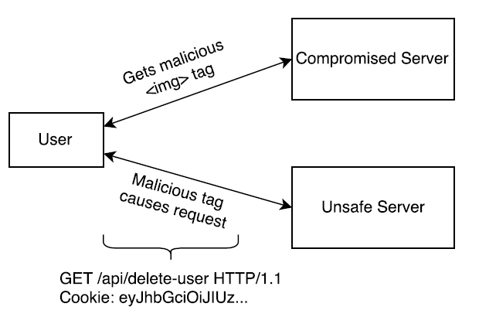
Security Considerations
Cross-Site Request Forgery (CSRF) (continued)

Slide 16
Security Considerations
Cross-Site Request Forgery (CSRF) (continued)
Short-lived JWTs can help in this case.
Common CSRF mitigation techniques include special headers that are added to requests only when they are performed from the right origin, per session cookies, and per request tokens.
If JWTs (and session data) are not stored as cookies, CSRF attacks are not possible.
Cross-site scripting attacks are still possible, though.

Slide 17
Security Considerations
Cross-Site Scripting (XSS)
Cross-site scripting (XSS) attacks attempt to inject JavaScript in trusted sites.
Injected JavaScript can then steal tokens from cookies and local storage.
If an access token is leaked before it expires, a malicious user could use it to access protected resources.
Common XSS attacks are usually caused by improper validation of data passed to the backend (in similar fashion to SQL injection attacks).

Slide 18
Security Considerations
Cross-Site Scripting (XSS) (continued)
An example of a XSS attack could be related to the comments section of a public site.
Every time a user adds a comment, it is stored by the backend and displayed to users who load the comments section.
If the backend does not sanitize the comments, a malicious user could write a comment in such a way that it could be interpreted by the browser as a <script> tag.
So, a malicious user could insert arbitrary JavaScript code and execute it in every user’s browser, thus, stealing credentials stored as cookies and in local storage.

Slide 19
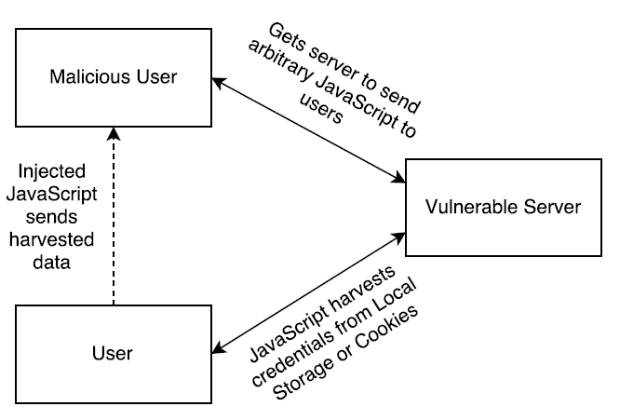
Security Considerations
Cross-Site Scripting (XSS) (continued)
Persistent Cross Site Scripting

Slide 20
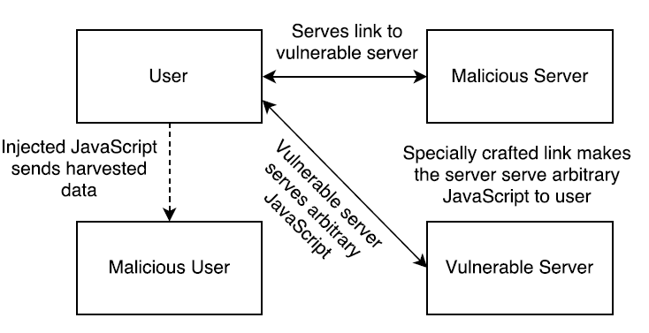
Security Considerations
Cross-Site Scripting (XSS) (continued)
Reflective Cross Site Scripting

Slide 21
JSON Web Tokens in Detail
As discussed above, all JWTs are constructed from three different elements:
the header
the payload
the signature/encryption data
The first two elements are JSON objects of a certain structure.
The third is dependent on the algorithm used for signing or encryption.

Slide 22
JSON Web Tokens in Detail (continued)
The Header
Every JWT carries a header with claims about itself.
These claims establish the algorithms used, whether the JWT is signed or encrypted, and in general, how to parse the rest of the JWT.
According to the type of JWT in question, more fields may be mandatory in the header.
For instance, encrypted JWTs carry information about the cryptographic algorithms used for key encryption and content encryption.

Slide 23
JSON Web Tokens in Detail (continued)
The Payload
The payload is the element where all the interesting user data is usually added.
In addition, certain claims defined in the spec may also be present.
Just like the header, the payload is a JSON object.
No claims are mandatory, although specific claims have a definite meaning.
The JWT spec specifies that claims that are not understood by an implementation should be ignored.
The claims with specific meanings attached to them are known as registered claims.

Slide 24
Passport JWT Strategy
As reviewed in previous lessons, Passport is a Node.js middleware that offers a variety of different request authentication strategies that are easy to implement.
By default, it stores the user object in session object.
As noted above, (JSON Web Tokens) JWTs is an authentication standard that works by assigning and passing around an encrypted token in requests that helps to identify the logged in user, instead of storing the user in a session on the server and creating a cookie.
It has different integrations including a Node.js module.

Slide 25
Passport JWT Strategy (continued)
Passport allows an option to store the user object in the request object instead of the session object.
To demonstrate Passport JWT we will add it to our passport-local strategy (username and password).
Now here is how everything is going to work:
When the user logs in, the backend creates a signed token and returns it in response
The client saves the token locally (typically in localStorage) and sends it back in every subsequent request that needs authentication
All requests needing authentication pass through a middleware that checks the provided token and allows the request only if the token is verified

Slide 26
Installation
We need to include additional npm modules:
npm install cors passport-jwt jsonwebtoken --save

Slide 27
Our Modified app.js
let createError = require('http-errors');
let express = require('express');
let path = require('path');
let cookieParser = require('cookie-parser');
let logger = require('morgan');
let cors = require('cors');
// modules for authentication
let session = require('express-session');
let passport = require('passport');
let passportJWT = require('passport-jwt');
let JWTStrategy = passportJWT.Strategy;
let ExtractJWT = passportJWT.ExtractJwt;
let passportLocal = require('passport-local');
let localStrategy = passportLocal.Strategy;
let flash = require('connect-flash’);
...
...

Slide 28
Our Modified app.js (continued)
...
...
...
// serialize and deserialize the User info
passport.serializeUser(User.serializeUser());
passport.deserializeUser(User.deserializeUser());
// verify that the token sent by the user - check if valid
let jwtOptions = {};
jwtOptions.jwtFromRequest = ExtractJWT.fromAuthHeaderAsBearerToken();
jwtOptions.secretOrKey = DB.secret;
let strategy = new JWTStrategy(jwtOptions, (jwt_payload, done) => {
User.findById(jwt_payload.id)
.then(user => {
return done(null, user);
})
.catch(err => {
return done(err, false);
});
});

Slide 29
Our modified controllers/index.js
let express = require("express");
let router = express.Router();
let mongoose = require("mongoose");
let passport = require("passport");
let jwt = require('jsonwebtoken');
let DB = require('../db’);
...
...
...

Slide 30
Our modified controllers/index.js
module.exports.processLoginPage = (req, res, next) => {
passport.authenticate('local’,
...
...
...
req.logIn(user,
(err) => {
// server error?
if(err) {
return next(err);
}
const payload = {
id: user._id,
displayName: user.displayName,
username: user.username,
email: user.email
}
const authToken = jwt.sign(payload, DB.secret, {
expiresIn: 604800 // 1 week
});

